Slide 1
Web Technology Lecture - 01
Md. Nurul ahad tawhid
Lecturer
Institute of information technology
University of dhaka

Slide 2
Content
Internet
History of Internet
Internet Terminology
Basic Services of Internet
WWW

Slide 3
Internet
The Internet (or internet) is a global system of interconnected computer networks that use the standard Internet protocol suite (TCP/IP) to serve billions of users worldwide.
Internet is a short form of the technical term internetwork, the result of interconnecting computer networks with special gateways or routers.
It is a network of networks that consists of millions of private, public, academic, business, and government networks, of local to global scope, that are linked by a broad array of electronic, wireless and optical networking technologies.

Slide 4
Internet was “born” in the late 1960s
Advanced Research Projects Agency (ARPA) or the US Department of Defense linked together mainframe computers to form a communications network.

Slide 5
The Agency’s main objectives
Create a communication system that could survive a nuclear attack or natural disaster
Provide communication links to its users in remote locations

Slide 6
ARPANet
Early version of the internet was known as ARPANet
ARPANET was the first WAN and had only four sites in 1969.
In 1989, the U.S. government lifted restrictions on the use of INTERNET, and allow its usage for commercial purposes as well.

Slide 7
internetworking
The process of linking a collection of networks is called internetworking
This term is where the internet got its name
The term internet was officially adopted in 1983.
More commonly referred to as the Net

Slide 8
ARPANet
Users originally used the internet to share
Scientific and engineering information
Other uses discovered
Email most popular
Expansion into Europe in 1970s

Slide 9
ARPANet splits into two parts
ARPANet and MILNet
MILNet
Various defence agencies and the military
ARPANet
Research and development network
International communication tool for the academic community

Slide 10
Mid 1980s
Speed of ARPANet backbone no longer sufficient
National Science Foundation (NSF) created a new high-speed network NSFNet

Slide 11
NSFNet
Two main objectives
To interconnect supercomputing centres so they could access one another’s recources
To give academic and research centres access to one another for purposes of exchanging information

Slide 12
ARPANet and NSFNet
Linked together but NSFNet had a faster backbone
By early 1990s NSFNet fully replaced ARPANet

Slide 13
Growth of Internet
Fueled by purchase of personal computers
Growing demand for “anytime, anywhere”
NSFNet academics only
Bell, AT&T and Nortel built high-speed backbones and new networks that used the same protocols

Slide 14
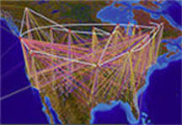
A Brief Summary of the Evolution of the Internet
Age of
eCommerce
Begins
1995
Mosaic
Created
1993
WWW
Created
1989
Internet
Named
and
Goes
TCP/IP
1984
TCP/IP
Created
1972
ARPANET
1969
Hypertext
Invented
1965
Packet
Switching
Invented
1964
First Vast
Computer
Network
Envisioned
1962
Silicon
Chip
1958
A
Mathematical
Theory of
Communication
1948
Memex
Conceived
1945
1945
1995

Slide 15
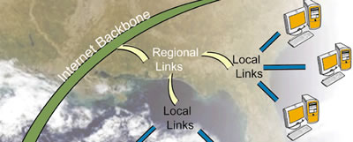
Internet Terminology
Backbone: defines main Internet routes
Constructed and maintained by major telecommunications companies
Is a term used to describe a structure that handles the major traffic in a networked system– much like a major highway
Network Backbone
is a “cyberspace highway” made up of high-speed cables and switching stations

Slide 16
Internet Terminology
TCP/IP
Transmission Control Protocol/Internet Protocol
Accepted means of communication
Protocol
Is an agreed upon format for transmitting data between two or more devices
A set of formal rules for transmitting data

Slide 17
Internet Terminology
Server software
IP Address: unique number for each Internet computer
Packets: small chunks of data ready to travel the Internet
Router: helps send along the packets to correct destination

Slide 18
Basic Services Of The INTERNET
World Wide Web
Electronic Mail (E-Mail)
File Transfer Protocol (FTP)
Telnet

Slide 19
Electronic Mail (E-Mail)
Allow user to send a mail (message ) to another internet user in any part of the world in a near-real-time manner.
E-Mail is a rapid and productive communication tool because
It is faster than Paper Mail .
Unlike telephone, The persons communicating with each other need not to be available at the same time.
Unlike Fax documents , Email documents can be stored in a computer and be easily edited using editing programs.

Slide 20
File Transfer Protocol (FTP)
Allow user to move a file from one computer to another on the internet.
Moving a file from a remote computer to ones own computer is known as Downloading.
Moving a file from ones own computer to a remote computer is known as Uploading.
Anonymous FTP site in a computer allows a user to log in with the username of anonymous and password that is user’s E-mail Address.
Anonymous FTP sites are called publically accessible sites because they can be accessed by any user on internet.

Slide 21
Telnet
Allow a user to log into another computer somewhere on the internet .
Some common uses of telnet service are -:
Using the computing power of the remote computer.
Using a software on the remote computer.
Accessing remote computers data base or archieve.
Logging into ones own computer from another computer.

Slide 22
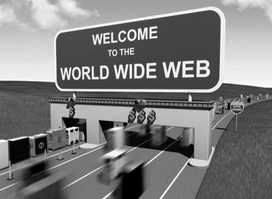

Slide 23
The World Wide Web (WWW)
World Wide Web or W3 is the most popular and promising method of organizing and accessing information on the INTERNET.
The World Wide Web (WWW) is a hypertext-based system that provides a 'user-friendly' interface to the collection of documents available on the Internet.
Through the World Wide Web, one can find vast amounts of information and electronic resources in any source or format such as images, videos, animations, sounds, interactive multimedia, and even virtual environments.

Slide 24
Web
The Web acts as an information resource that provides or serves and/or accesses and views information to all those computers connected to the Internet using the Hypertext Transfer Protocol (HTTP).
HTTP is the communication protocol used by the computers to send and/or retrieve Web documents.
Browsers are used to view Web pages, which are located through their Uniform Resource Locators (URL).
Web pages are created using a coding language called Hypertext Markup Language (HTML).

Slide 25
Client and server
Web access is based on client/server technology.
The Web uses the distributed client server computing model, which generally classifies computers connected to the Internet as either a server or a client computer that transmit information using HTTP.
Consists of –
Server Computers
Client Computers

Slide 26
Server Computers
A web server is a computer running application software that listens and responds to a client computer’s request made through a web browser. The computer is often called a “web server”.
It is the machine that hosts web pages and other web documents. It provides web documents and other online services using the HTTP. Ex. Apache, iServer, Microsoft Internet Information Server (IIS)
Most machines work as web server, mail server and FTP server at the same time.
Big web sites usually have dedicated machine(s) as their web server(s) to provide better, faster and more efficient services.

Slide 27
Client Computers
Client computers access web documents using an application program called a web browser.
A computer connected to the Internet may be both a server and a client.
But companies or organizations normally run servers, while computers used by individuals who simply access the Web are client computers.

Slide 28
Web Browser
A web browser is application software that is used to locate and issue a request for the page on the web server that hosts the document.
It also interprets the page sent back by the web server and displays it on the monitor.
It is therefore a computer program that lets you view and explore information on the World Wide Web. Ex. Microsoft Internet Explorer, Mozilla Firefox

Slide 29
Web Browser cont..
Browser provide following navigation facilities –
Do not require a user to login to a server computer.
Enable a user to visit a server computer’s site directly and access information on it by specifying its URL (Uniform Resource Locator).
Enable user to create and maintain a personal hotlist of favourite URL.
Maintain a history of server computers visited by user in a surfing session.
Enable a user to download information in various formats.

Slide 30
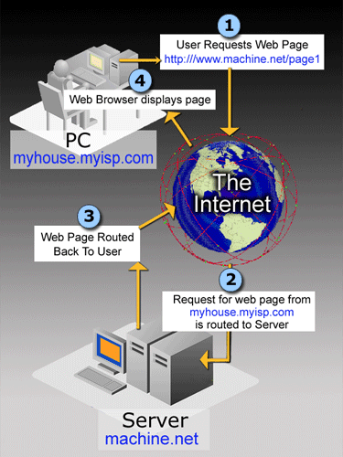
How the Web works?
A simplified illustration of how the web works:
1. User sends request
2. Browser interprets user’s selection and makes request from appropriate server
3. Server accepts and processes request from browser and sends requested files to browser to be interpreted
4. User receives file displayed by the browser

Slide 31
Terms to Be Familiar With
Hyper Text Transfer Protocol (HTTP)
is the communication protocol used by computers connected to the World Wide Web to communicate with each other.
It is a specific set of rules followed by computers to send and retrieve Web documents. Other Internet services use different protocols to send and retrieve information.
Hypertext
Generally any text that contains "links" to other text.
It is a technology that presents and correlates information by using nonlinear, non-sequential links rather than linear sequences.
The Web's hypertext documents or Web pages allow you to view related information within a document or between two documents through hyperlinks.

Slide 32
Terms to Be Familiar With
Hyperlinks
commonly called as links, the easy-to-spot underlined words or phrases and/or icons, graphics or images, you click on within a Web page to view related and/or additional information.
Hyperlinks contains HTML-coded references that allow you to jump to or view the linked information or even other application.
Hypermedia
is simply defined as the combination of hypertext and multimedia.
Hypermedia integrates text, images, video, audio, virtual environments, other electronic resources and supported applications including hypertext into its documents.

Slide 33
Terms to Be Familiar With
Uniform Resource Locators (URL)
URLs are the addresses of documents or the pathways used to find and access files available on the Internet.
Web pages are accessed using URLs (Uniform Resource Locators).
It is simply an address that is typed into the search box of a browser, which will tell the Web server which web page to retrieve.
With a URL, you can go directly to a specific document, rather than selecting links from other documents.
Web
protocol
standard
Web
server
name
Folder
name
Document name
and filename
extension
http://www.cnn.com/showbiz/movies.htm

Slide 34
Terms to Be Familiar With
Web page
It is a document written in the HTML coding language, and may include pictures, sound and/or animation even virtual environments.
It resides on a web server; a computer that stores, processes, accesses and serves information.
It typically has links to other documents residing on the same computer or other computers.
A Web site is the entire collection of web pages offered by an organization or an individual.

Slide 35
Terms to Be Familiar With
homepage
It is the very first page someone will most likely see when s/he visits an individual or organization’s Web site.
This is the reason why people refer to the homepage when they are actually referring to the Web site.
The homepage of an organization or individual provides its identity to the World Wide Web. In addition, it typically serves as a table of contents, index, or directory to a set of web pages offered by an organization or an individual.
A library's home page usually provides access to information about that library and all the other Web pages regarding its services and resources. It may also provide links to other Library Web sites or other Internet resources that the institution finds useful and interesting. Basically, we could say it functions as your library's "home" in the World Wide Web that also serves as the "door", the entry point to your Web site.

Slide 36
Domains
Domains divide World Wide Web sites into categories based on the nature of their owner, and they form part of a site's address, or uniform resource locator (URL). Common top-level domains are:
.com—commercial enterprises
.mil—military site
.org—organization site (non-profits, etc.)
.int—organizations established by international treaty
.net—network
.biz—commercial and personal
.edu—educational site (universities, schools, etc.)
.info—commercial and personal
.gov—government organizations
.name—personal sites

Slide 37
End

